Slide 1

Understanding Jewish Trauma: The Therapist’s role in Bearing Witness and Building Resilience – Dr Tracey Farber Clinical Psychologist

Slide 2
Jewish Trauma
Time line
Common Themes
The Holocaust (1939 – 1944)
Wars in Israel
7 October 2023 - 1200 killed 250 hostages taken
2 year war in Israel
Bondi Beach terror attack (14/12/2025)
Operation “Roaring Lion” (2026)
Jews are killed “ Kiddush Hashem”
Terror
Jew are dehumanized
Traumatic Bereavement
Long term traumatic stress symptoms
Tigger or re- triggering
Transgenerational trauma
Spiritual crisis for many traumatized people

Slide 3
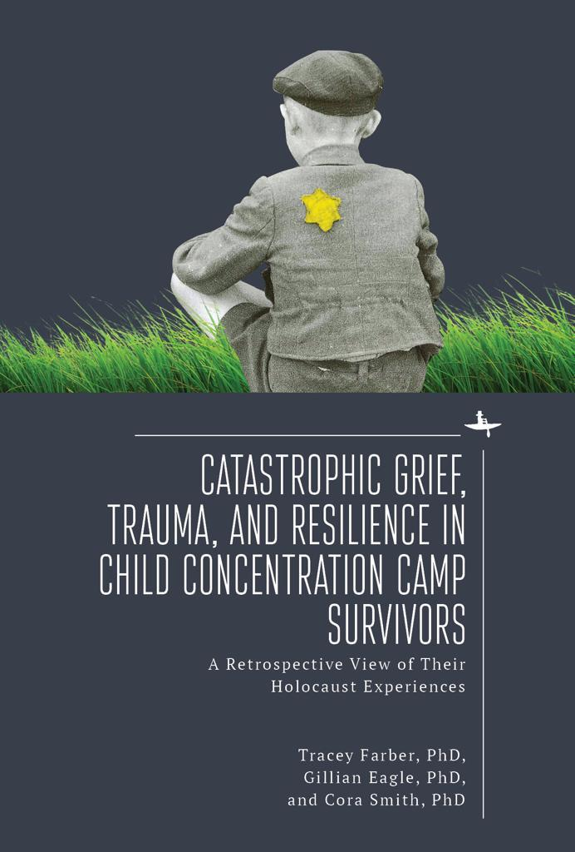

Slide 4
Gerson ( 2009) quotes a survivor “ I would be entirely hopeless, if I could not be truly hopeless with you”

Slide 5
Looking back the research taught me the power of being a witness. My gratitude to the survivors who taught me about the importance of being a witness and this influenced my work as a therapist. Empathy build a bridge between the therapist and client and lessens the existential aloneness of the trauma survivor. As a supervisor I have underscored the importance of presence, and empathy.

Slide 6
Encounters with profound suffering often evoke helplessness in the therapist ; however, empathy and the therapeutic act of bearing witness remain central, empowering processes in psychotherapy (Laub, 1984).

Slide 7
Dr Hillel Klein ( 20212) Survival and Revival
Every person has an individual response to a mass trauma
Individual history, early attachments play a role
Capacity for hope that develops in early attachment builds the child’s sense of agency. This gives birth to the ability to hold onto hope in adulthood
Hope is critical for survival
This relates to the individuals ability to adapt and walk forward in the face of trauma - resilience

Slide 8
Trauma Shatters: The self Sense of safety Assumptions about meaning and fairness Spiritual connection Relational connections Communities

Slide 9

Freud ( 1920) described trauma as the shattering of a trauma shield. ( Defences get shattered by trauma)

Slide 10
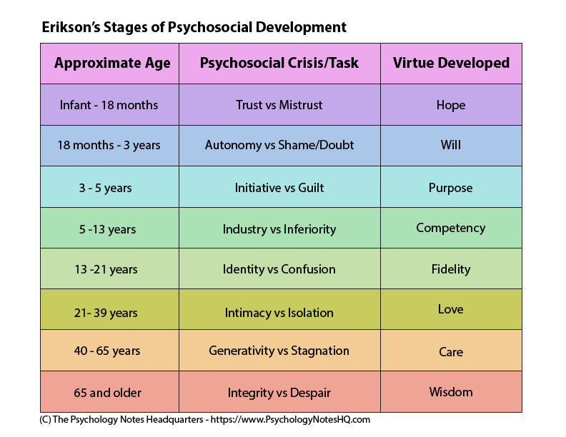
DEVELOPMENTAL DISRUPTION / RUPTURE FROM TRAUMA

Slide 11
Shattered defences:
Anxious all the time
Fear catastrophe
Regressed
Struggling to function
Dissociation – disconnection between though and feeling
Cries a lot
All defences get shattered, including self esteem and issues related to pre-trauma struggles
People feel like they are “crazy” - loss of previous self

Slide 12

Psychological defences are like gates. These “gates” help us to keep our feelings/thoughts in control
Often trauma breaks our defences/ “gates”:
Broken Defences:

Slide 13
Shattered Assumptions theory posits a breakdown of positive assumptions about the self and the world; those assumptions that provide us with a sense of relative invulnerability
Janoff - Bulman, 1992
Assumptions:
The world is benevolent/ kind
The world is meaningful or fair
The self is worthy

Slide 14
Dr Judith Lewis Herman's premise is that trauma catastrophically shatters our sense of connectedness to self and other, and her model aspires to help people gradually, gently reestablish those connections. Trauma and Recovery ( 1992).

Slide 15
Bearing Witness to
Grief – the loss of the self and the loss of the other
Guilt and shame – survivor guilt
Horror
Helplessness
Existential aloneness
Rage
Spiritual rupture

Slide 16
Trauma Trilogy of Catastrophic Grief, Anger and Survivor Guilt ( Farber, Smith & Eagle 2021)
Emotional Themes:
Catastrophic grief – overwhelming grief caused by massive, traumatic loss.
Survivor guilt – guilt about having lived while others died.
Anger – rage toward perpetrators, bystanders, or the injustice of the event.
These three emotional experiences are often linked together.
Often survival guilt and anger are ways of avoiding profound grief
Survivor guilt is often very destructive – the person feels unworthy of living/enjoying life.

Slide 17
Spiritual Rupture
Individuals vary in their sense of “ shattered faith”
For some faith is reinforced
For others faith is lost
Juni (2015):
Role of the therapist is to support the survivor and not try to convince them one way or the other.
When faith is shattered there is an extreme sense of existential aloneness and sometimes fear and shame. There is a great need for emotional support

Slide 18
Bearing Witness
Dori Laub, ( 1992/2005) psychoanalyst, psychiatrist Holocaust survivor says that the story comes alive and is experienced when the survivor tells the listener
For Laub there is a healing process in telling the story to an emotionally present listener
The listener ( witness) is in an co- creative process with the survivor and in hearing the story the therapist becomes the witness

Slide 19
Laub ( 1992) says that survivors often remain haunted with traumatic memories that have no closure. He said that despite outward success, survivors were had a “fragility, a woundedness that defies all healing” ( p.72) Bearing witness to the trauma – gives the survivor an opportunity to face loss and mourning.

Slide 20
Existential Aloneness - Zahavah Solomon
“ No one can fully know, share or enter my traumatic experience”
A person can be surrounded by others and still feel alone
Trauma creates an experience that cannot be fully shared
This produces a feeling of being a sole bearer of unbearable knowledge

Slide 21
Dr Ofra Eshel ( 2013) calls “withness” ( being a witness and being with) being emotionally present in the patient’s experiential world. The therapist’s compassionate presence creates a shared experience that allows traumatic states to be endured and transformed.

Slide 22
Three perspectives on bearing witness
Laub : Tell me what happened
Solomon: I can hear you feel very alone as if no one can understand
Eshel I will stay with you anyway

Slide 23
As well as witnessing – consequences need to be pointed out clients reenacting trauma Interpretations need to be carefully timed with respect for the clients shattered defences

Slide 24

Empathy builds resilience

Slide 25
Empathy and feeling heard may in some way lessen survivors sense of hopelessness and despair. Krell (2013)child survivor and psychiatrist explains “ No survivor truly expects to be understood. Our need is to be heard”

Slide 26
Psychotherapy offers a safe space to explore and express feelings. This helps us to understand painful feelings and inner conflict – feeling deeply understood builds resilience. The therapist must recognise the client’s strengths – this builds mastery

Slide 27
Building resilience
Walking forward in the face of trauma
Finding sparks of hope in the darkness
A long road of processing trauma and grief
Walking with unbearable grief and trauma - and in parallel finding meaning, giving and receiving love and glimmers of joy
Post Traumatic Integration

Slide 28
WITS MODEL
Tell the Story
Normalise feelings
Reframe Guilt
Encourage mastery
Meaning

Slide 29
Traumatic Countertransference
The therapist needs to be witnessed
Therapist needs to be seen and heard
Therapists can experience existential aloneness from trauma work
Connect with others
Self care is critical
Find her life force, feel her life force

Slide 30

How do we express our aliveness ?
Esther Perel

Slide 31


Slide 32

Thanks
Feedback: farbertracey@gmail.com
Cell 0538974898

