Slide 1

Regulation Through Relationships: Parenting and Child Sleep
Anat Scher
School of Therapy, Counseling and Human Development
University of Haifa, Israel
anats@edu.haifa.ac.il
AJP Webinar
24/2/2026

Slide 2


The 3 Rs in development
Rest
Sleep
Regulation
S-W States
Relationships
Caregiving

Slide 3


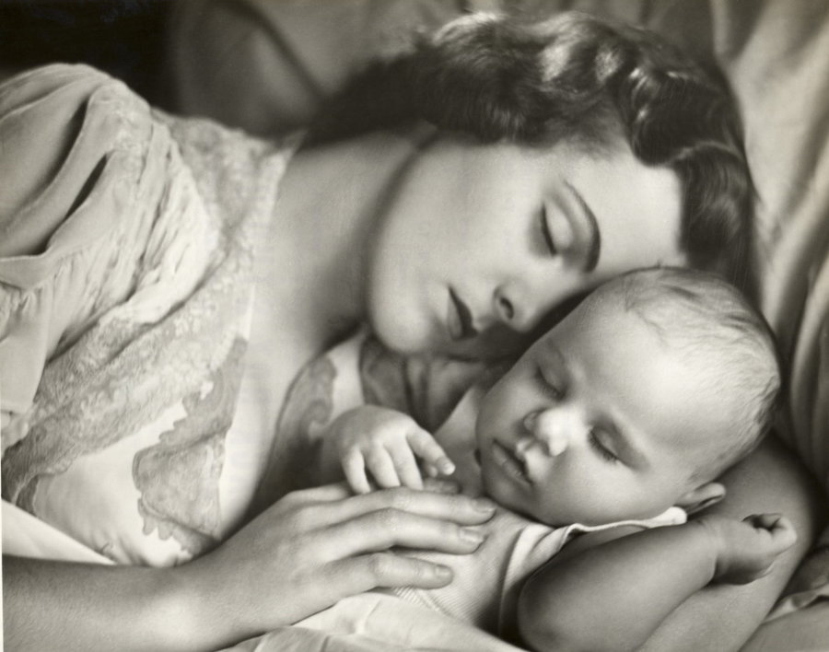

infants (H & A) Sleep in Regulatory Relational context

Slide 4
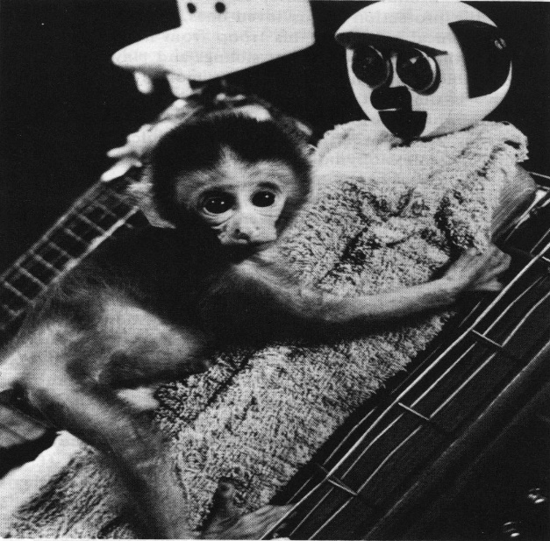

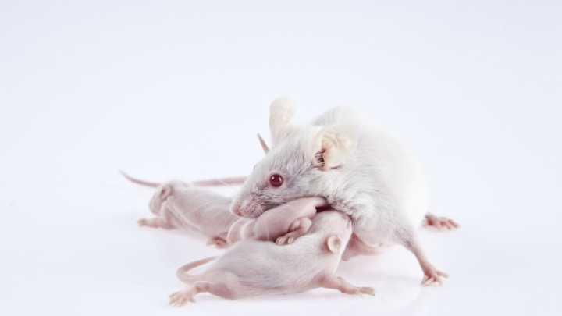
Caregiving practices regulate offspring dev
Security
Proximity
Physical contact

Slide 5
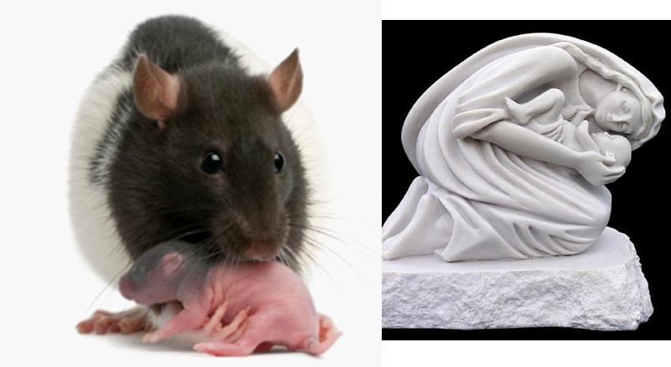
Mothers as External Regulators
licking and grooming
temperature regulation
Behavioral outcomes
protection
Security
attachment
from animal models to humans

Slide 6

Sleep “Basics“
Sleep is fundamental
survival & optimal functioning
Sleep supports
physical recuperation
growth, immune system, brain dev.
learning, memory consolidation,
emotional regulation
A good night sleep is important for child and parent health and the well-being of the family
Sleep “difficulties” - parental concerns are common (25%-50%)
Parents often seek advice

Slide 7
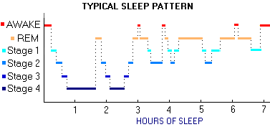
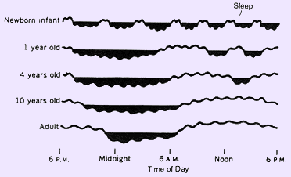
Sleep Architecture
Dev. Task:
Regulate &
Consolidate
From polyphasic to
Nocturnal + naps
In early development sleep is the dominate state

Slide 8
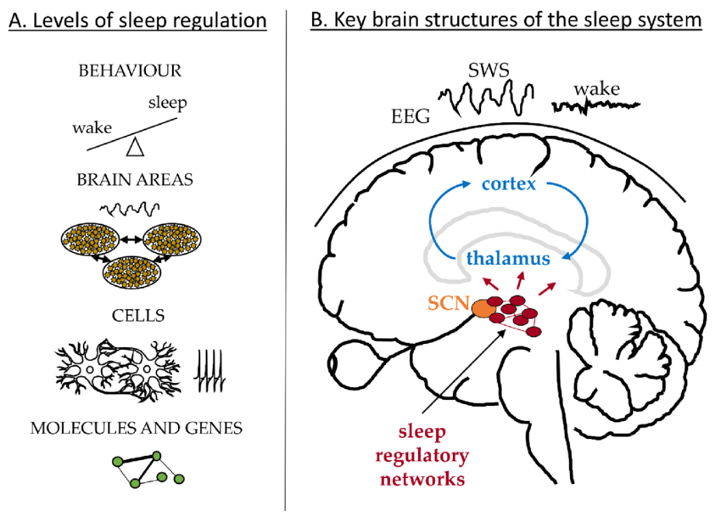
Level and Brain Sites of Sleep Regulation

Slide 9
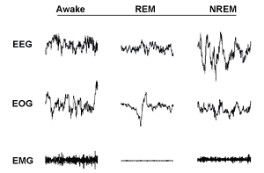



Sleep-Wake Regulation Where Biology & Caregiving meet
brain
eye
motor

Slide 10


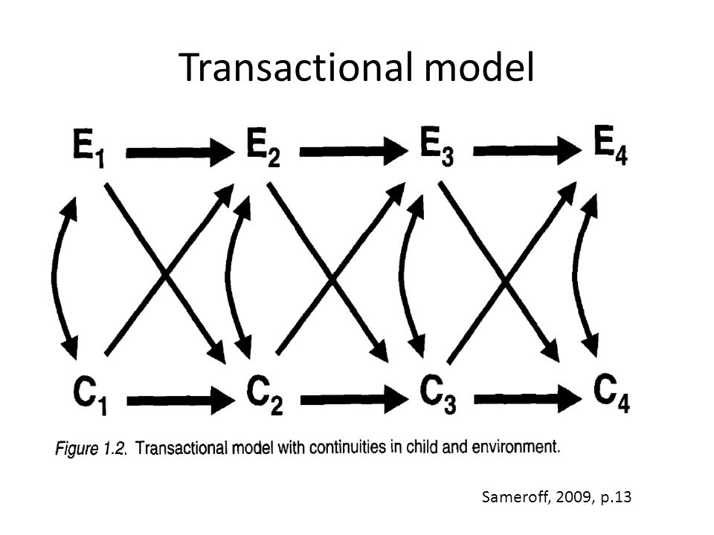
Transactional Model of Development Sameroff & Chandler (1975)
Development involes ongoing interactions between individuals, such as a child and parent, resulting in the modification of each individual’s behavior
Arnold Sameroff

Slide 11
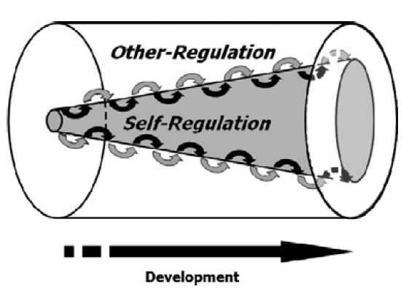
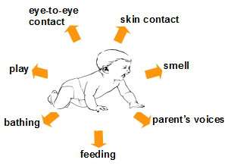
A Unified Theory of Development:
A Dialectic Integration of Nature and Nurture
Sameroff CD 2000
Sleep ?
"ice-cream-cone-in-a-can”
Notes:
˿

Slide 12
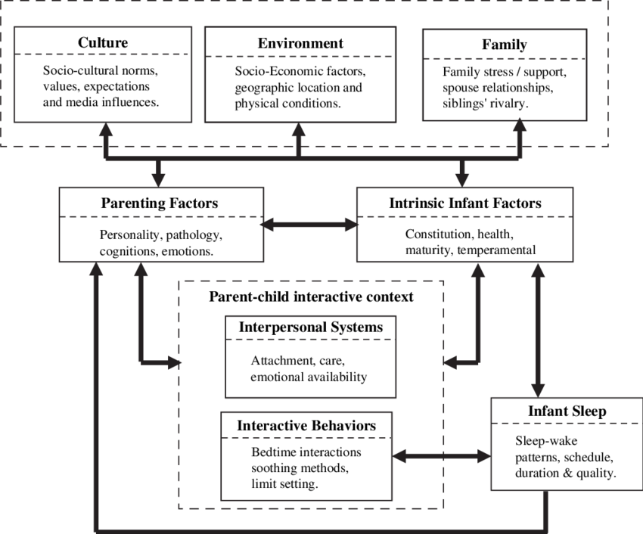
Transactional model of children’s sleep
(Sadeh & Anders, 1993)

Slide 13

Sleep and Separation
From Attachment perspective, separation at bedtime, and the absent caregiver, when awakening occurs, are anxiety-provoking instances (Bowlby 1973).
A. Freud (1965) maintained that going to bed is a prototype of separation; in going to bed, the child is required to separate physically from the parents and disengage from events of the day.
Separation at night anxiety & distress in the dyad

Slide 14


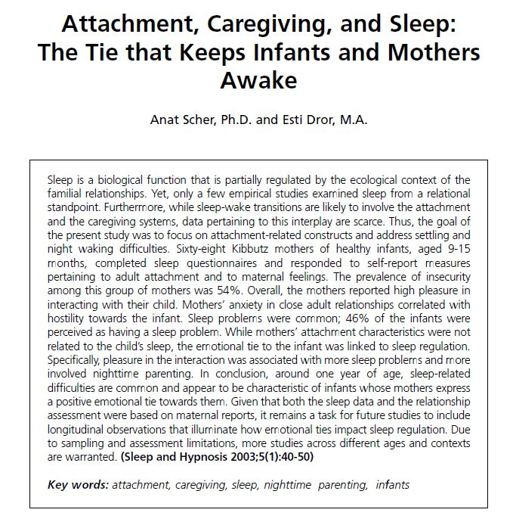
Attachment- Caregiving model
George & Salomon (1996;2008)
In situations of danger (real or imagined)
caregiving drive is activated
Motivation to provide protection
Activated by child attachment behavior
Driven by fear of danger
Triggered by parental anxiety
Attachment system seek protection
Caregiving system provide protection.
C

Slide 15

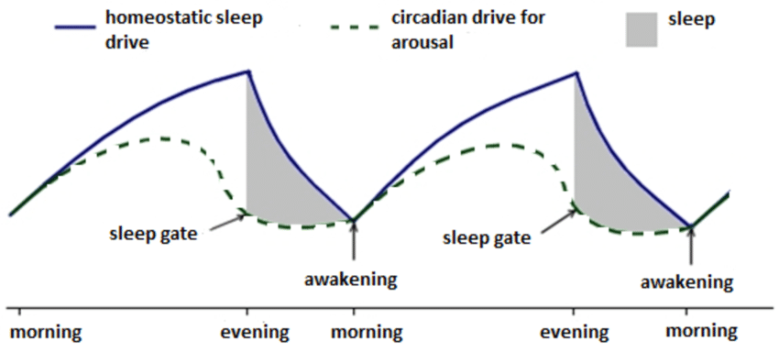

Conflicting needs: a parenting challenge
Caregiving System vs. Sleep Drive
Survival motivation
Protection of offspring
Proximity
Regulation
Two-process model of sleep regulation
Homeostatic & Circadian
Borbély (1975; 2022)
Caregiving System vs. Sleep Drive
Survival motivation
Protection of offspring
Proximity
Regulation

Slide 16

Maternal Separation Anxiety
MSA - unique dimension of motherhood - her own feelings when separated from her child and concerns regarding child distress during separation.
Unpleasant emotional state that reflects concern and apprehension about leaving the child.
MSA involves feelings of guilt, worry, and sadness that accompany short-terms separation from the baby.
The concept of mothers’ separation anxiety is often used in clinical setting.
But the parental side of separation anxiety has attracted only limited research.
Among the few researchers that empirically studied MSA is E. Hock (1984;1989).
Measurement
1.mothers’ own feelings during separation
2. perception of the child’s feeling during separation
3. concern over alternative care

Slide 17
Study 1: MSA and child sleep
Participants n=118 dyads
Method home/lab visits at 3,6,9, 12 months
Tools sleep + MSA Q
Main Findings
At 3m anxiety and sleep were not related
At 9 and at12m - higher levels of anxiety were associated with sleep disruption
MSA at 3m significantly predicted subsequent sleep difficulties
Infants of high anxiety mothers were “night-wakers”

Slide 18
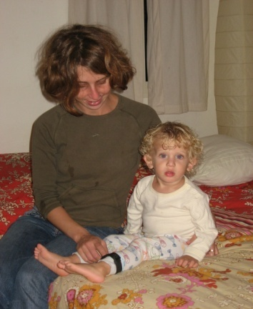
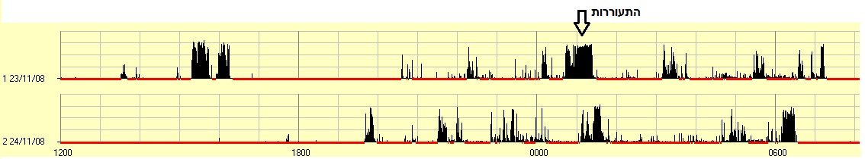
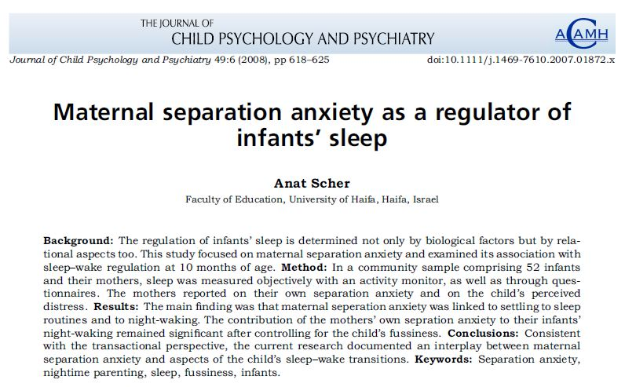
Study 2: MSA and child sleep by actigraphy
Participants 61 dyads
R. Design Longitudinal from 8M to 14M
Main Findings
High MSA (8M)
more night-waking concurrently
predicted more night-waking (12M)
controlled for temperament (r=.33)

Slide 19
From Dyad to Family
Family System
Relational Constructs
Differentiation of
Self

Slide 20
Bowen’s Family Systems Model
DoS and Parenting
Skowron et al 2010
Parents with high DoS are less emotionally reactive and maintain coherent sense of self in their relathionship with the child while encouraging autonomy and independence
BFST
Bowen 1978
The family is an emotional unit that aims to attain equilibrium in times of stress and anxiety
Differentiation of Self
Skowron 2005
individual’s ability to maintain autonomous sense of self within the family, and experience both intimacy and independence without fear of engulfment

Slide 21
Methodological Approach
Study 3: Mothers’ DoS and Tddlesr’ Sleep
A mixed-method design, conducted in two stages:
First stage
Second stage
A community sample of 130 mothers completed self-report questionnaires (MSAS, DSI-R and sleep questionnaires)
Mothers were interviewed using a semi-structured format
Children’s sleep was assessed by actigraphy on 3 consecutive workweek nights
Based on the DSI-R two subgroups of mothers with high (n=20) vs. low (n=20) DoS were identified

Slide 22
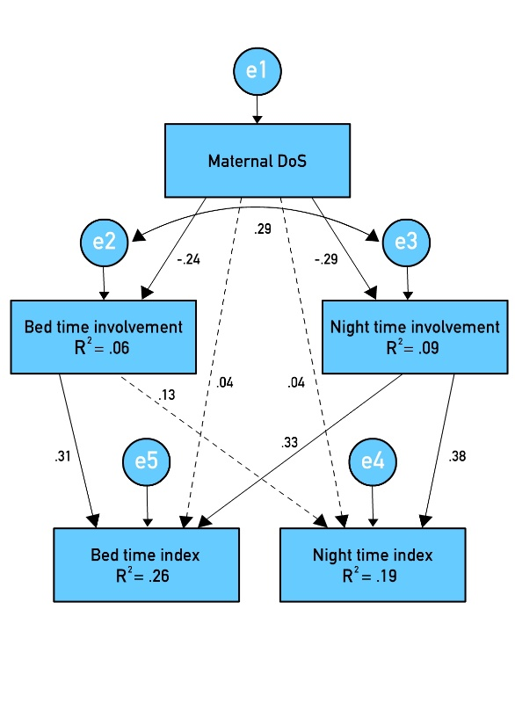
SEM: contribution of DoS to sleep disruption (n=130)
Min awake (objective): High vs Low groups
WAKE (min) | 55.6 (31.10) | 44.8 (23.80) | 66.3 (34.2) | 5.32* (.12)
nighttime parenting mediates link between DoS & sleep disruption
Χ²₍₃₎ =3.44, p=.329, CFI=.99, NFI=.97, IFI=.99, RMSEA=.03, SRMR=.03

Slide 23
Mothers in the High DoS group
Reported both childhood and current sleep difficulties
Tended to keep a flexible yet inconsistent bedtime routine
Reported active and physical sleep related involvement
Assigned emotional interpretations to the child sleep behaviors
“My sleep has always been light, ever since I was a child. I don’t think I ever slept well. Maybe that’s why it doesn’t bother me so much to wake up at night, I’m used to it, and it’s more important to me to be there for them”
(Melody, low DoS group)

Slide 24
Mothers in the Low DoS group
Reported good sleep both at childhood and at present
Tended to keep a consistent bedtime routine
Encourage their children to be autonomous at bedtime and upon night awakenings
Respond to child sleep behaviors in a practical manner
"Basically our job is to teach her the right sleeping habits. Just help her to adopt proper sleeping habits. Without having to hold her hand, or things like that that in the long run end up making things harder for her"
(Lauren, high DoS group)

Slide 25
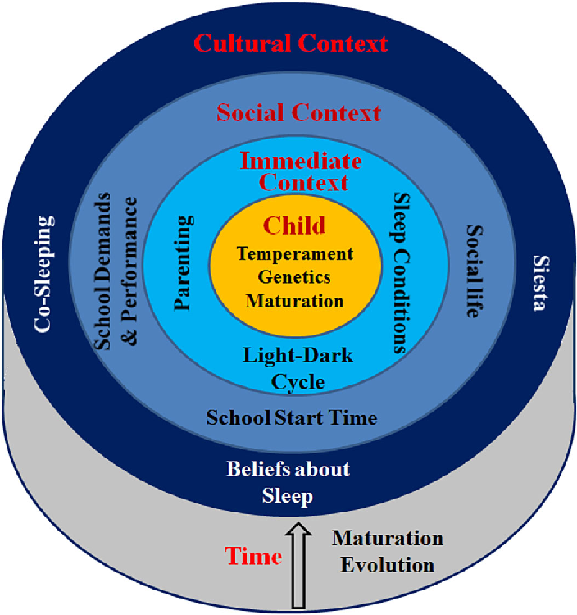
From Micro system to Cultural context
El-Sheikh & Sadeh (2015): Sleep and Development inspired by Bronfenbrenner (1979) Model

Slide 26
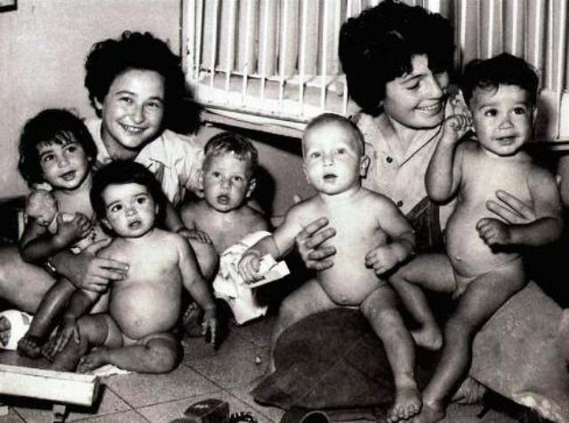
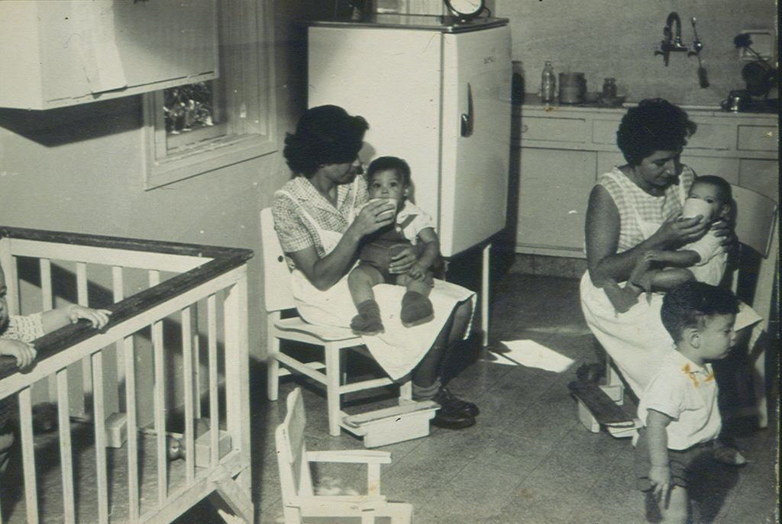
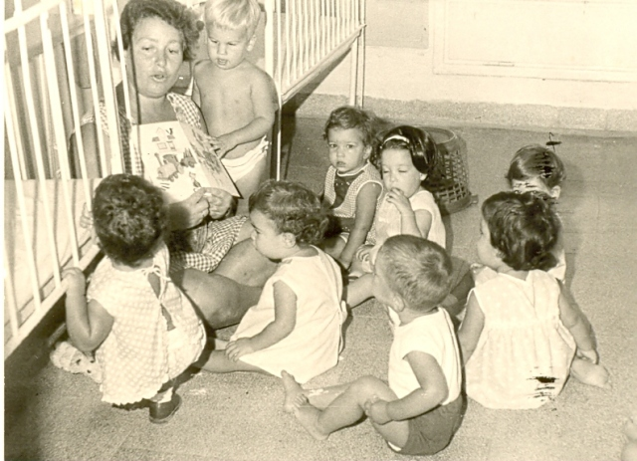
Study 4: Kibbutz setting

Slide 27
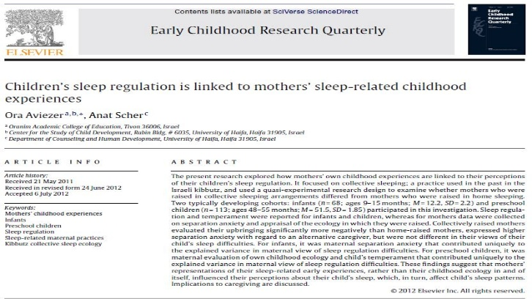
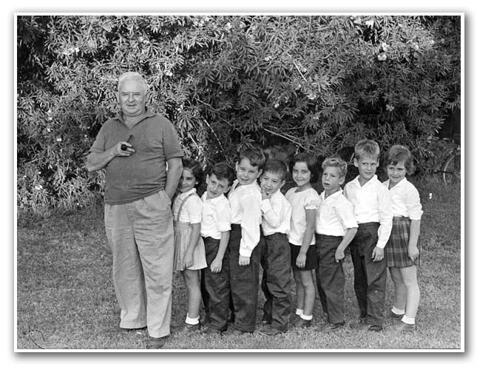

Kibuttz: A quasi-experimental (exp by nature)
Communal sleep vs. Home sleep
similar ideology/demographics
Communal sleep: risk factor for in secure relationships (C type)
Childhood - all mothers were Kibbutz raised, in either C or H sleep
Now - all their children sleep at H (C-sleep abolished)
Two age groups: Infants and preschoolers
Main Findings
Infants MSA - predicted sleep difficulties
Preschoolers mothers’ mothers’ subjective evaluation of their growing-up context (positive/negative) correlated with their child sleep
Negative memories > sleep difficulties

Slide 28
Growing-up in Kibbutz: Memories count
Ghosts ?
Angeles?

Slide 29
Summary & Conclusions I
sleep pattern & habits of young children often present caregiving challenges
rooted in evolution and survival motivational systems – nighttime caregiving & protection are essential regulators of child sleep and development
parental cognitions, bedtime practices, and nighttime caregiving are among the factors that also shape sleep

Slide 30
Summary & Conclusions II
psychological attributes of parents, such as separation anxiety & differentiation of self, shape their behavior and in-turn their child’s sleep
parents’ own past and present sleep-related experiences also impact children’s sleep patterns
reasons for sleep-wake regulation difficulties lie in the child, the parent and/or their interactions
culture

Slide 31


Slide 32
Anders, T. (1994). Infant sleep, nighttime relationships, and attachment. Psychiatry: Interpersonal and Biological Processes, 57, 11-21.
Meltzer, L. J., & Mindell, J. A. (2014). Systematic review and meta-analysis of behavioral interventions for pediatric insomnia. Journal of Pediatric Psychology, 39(8), 932-948.
Philbrook, L. E., & Teti, D. M. (2016). Bidirectional associations between bedtime parenting and infant sleep: Parenting quality, parenting practices, and their interaction. Journal of Family Psychology, 30(4), 431.
Sadeh, A., Tikotzky, L., & Scher, A. (2010). Parenting and infant sleep. Sleep medicine reviews, 14(2), 89-96.‏
Scher, A. (2008). Maternal separation anxiety as a regulator of infants’ sleep. Journal of Child Psychology and Psychiatry, 49, 618-625.
Scher, A. (2001). Attachment and sleep: A study of night waking in 12‐month‐old infants. Developmental Psychobiology: The Journal of the International Society for Developmental Psychobiology, 38(4), 274-285.‏
Scher, A., & Asher, R. (2004). Is attachment security related to sleep–wake regulation?: Mothers’ reports and objective sleep recordings. Infant Behavior and Development, 27(3), 288-302.‏
Aviezer, O., & Scher, A. (2013). Children's sleep regulation is linked to mothers’ sleep-related childhood experiences. Early Childhood Research Quarterly, 28(2), 271-281.‏
Simon, T., & Scher, A. (2023). Maternal differentiation of self and toddlers’ sleep: the mediating role of nighttime involvement. International Journal of Environmental Research and Public Health, 20(3), 1714.‏

