Slide 1
Body Image, Eating Disorders: The Jewish Experience
Madeline Altabe, PhD
Associate Professor & PsyD Coordinator – Brenau University
AJP Education Committee
Association of Jewish Psychologists Webinar
July 23, 2025
Notes:
Mostly North America – lots of great Israeli research too!

Slide 2
Learning Objectives
• Develop an understanding of the socio-cultural theory of body image – how cultural norms come to influence identity and create vulnerabilities to eating disorders
•Articulate the relationship between systemic discrimination and eating disorders risk
•Review Jewish specific research on body image and identity
•Apply specific strategies that build on Jewish resilience to improve body image and reduce eating disorders risk

Slide 3
Biopsychosocial Model of Eating Disorders
Biological: gene studies
Psychological: personality traits, individual experience with trauma
Social - unrealistic beauty standards internalized. Objectification of the female body
Notes:
Objectification: Body objectification is a terminology commonly used to describe the culturally sanctioned dehumanization of individuals into a fragmented assortment of sexualized body parts. This pervasive form of sexist oppression constitutes a harmful cultural practice that disproportionately targets and exacts its toll on women and girls. (Webb & Jafari, 2017)

Slide 4
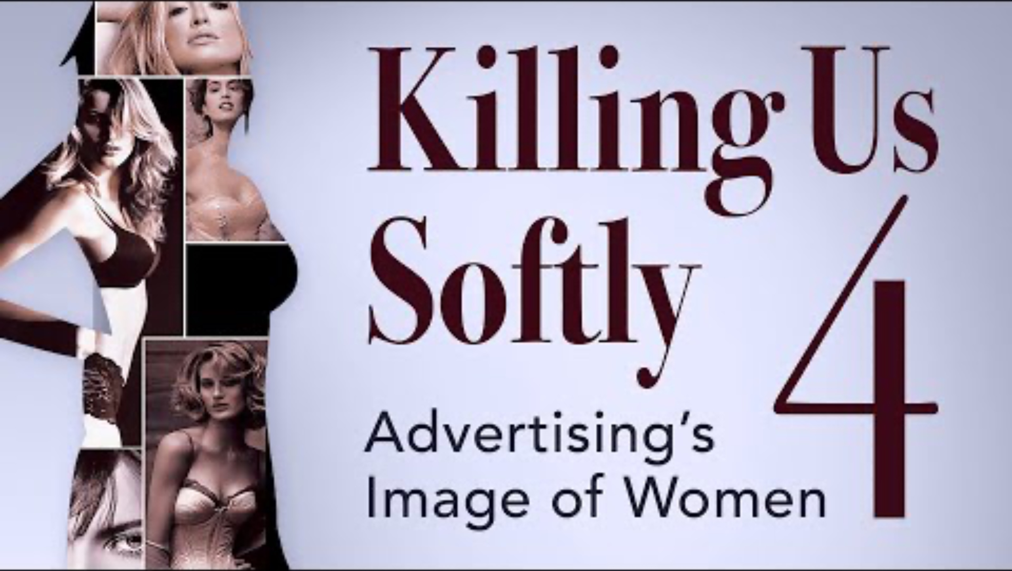
Objectification – why it’s a problem.
Jean Kilbourne EdD, social commentator
Objectification of women here – but concept may extend to other identities

Slide 5
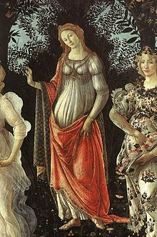
Beauty Ideals – Origins
Symmetry, Waist/hip ratio in women - maybe biological markers
Ancient Greece gave us beauty ideals - based in cultural/religious meaning
European ideals (middle ages) - denial of the body in favor of closeness to divine - Saint Catherine (14th century anorexia)
Thin ideal became the standard in 20th century Western Countries and spread; considered Eurocentric and oppressive of other groups
This Photo by Unknown Author is licensed under CC BY-SA
Notes:
https://www.curationist.org/editorial-features/article/female-fertility-figurines-in-the-ancient-mediterranean
Symmetry comes from bio-evolutionary research - use ancient statue
Greek - ideal use statute
Boticelli Venus
20th century and spread - Fiji and recent writing about women of color

Slide 6
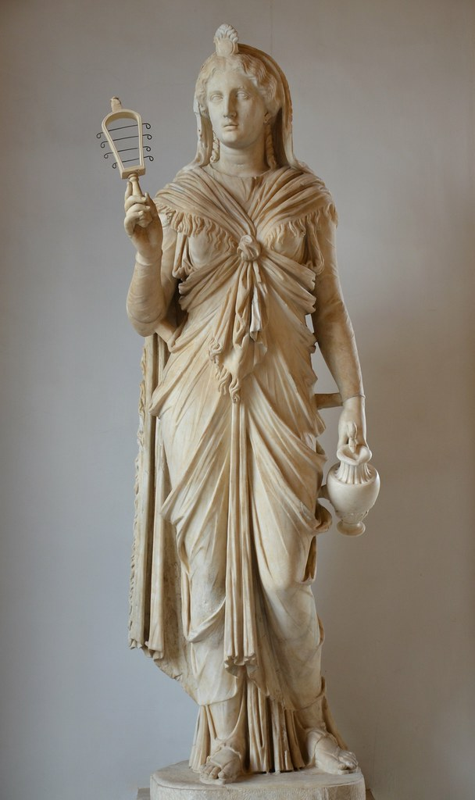
This Photo by Unknown Author is licensed under CC BY-SA
Notes:
Greek Stute of Aprhrodite

Slide 7
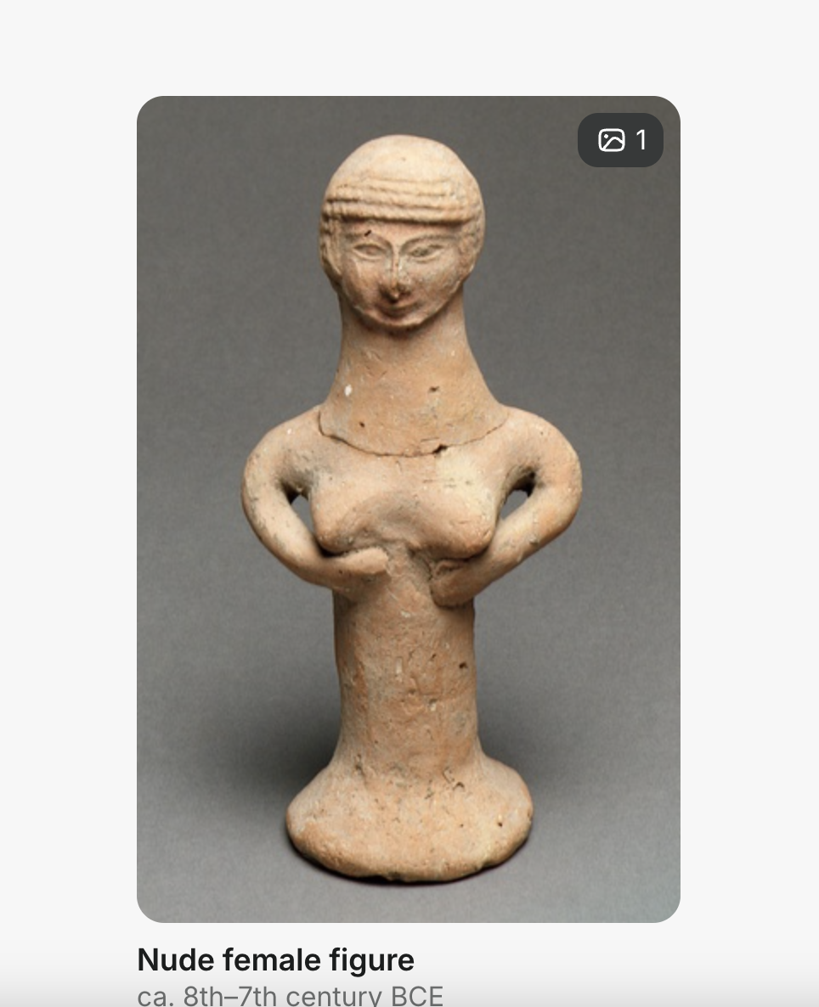
Notes:
Jewish ancient art – from the Metropoliton Museum of Art NY
complex body as symbol question on a cultural level – experienced at the personal level.

Slide 8

How do we know systematic discrimination impacts BI & ED?

Slide 9
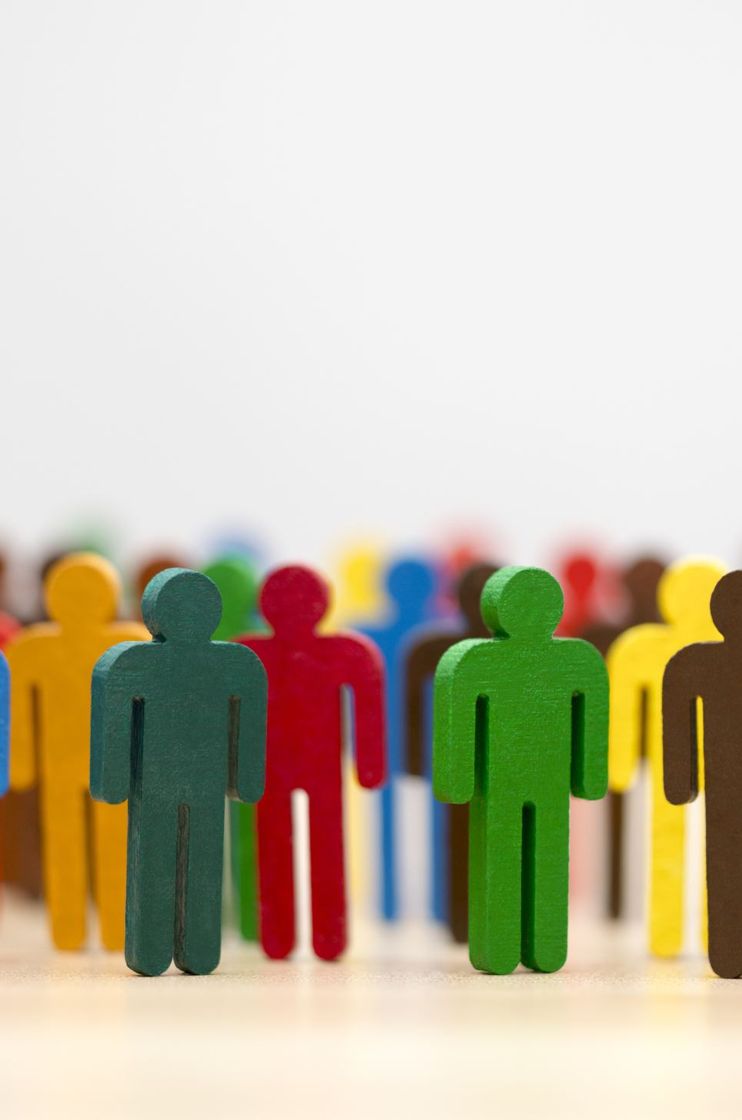
Body Image and Sociocultural view of Eating Disorders
Part of the DSM criteria for ED
Remains an ongoing area of research and treatment development in the field
Led to other questions about how cultural ideals, discrimination based on physical traits impact youth and emerging adults
Notes:
Body image is formed in adolescence as part of identity: ED typically begins in adolescence but may be a lifetime vulnerabilithy

Slide 10
Social experience that impact ED
Teasing
Sexual and physical abuse
Acculturative stress
Discrimination
Notes:
Normal development helps us to learn our cultural norms and incorporate into our sense of self and our sense of our body in the world. These adverse experience disrupt healthy development.

Slide 11

Weight/Size Discrimination & Other Biases (Mason, et al., 2021)
Weight/size discrimination - (e.g. teasing) predicts ED
Meta-analysis - racial discrimination is a modest predictor of ED
Combinations of multiple forms of discrimination increase risk

Slide 12
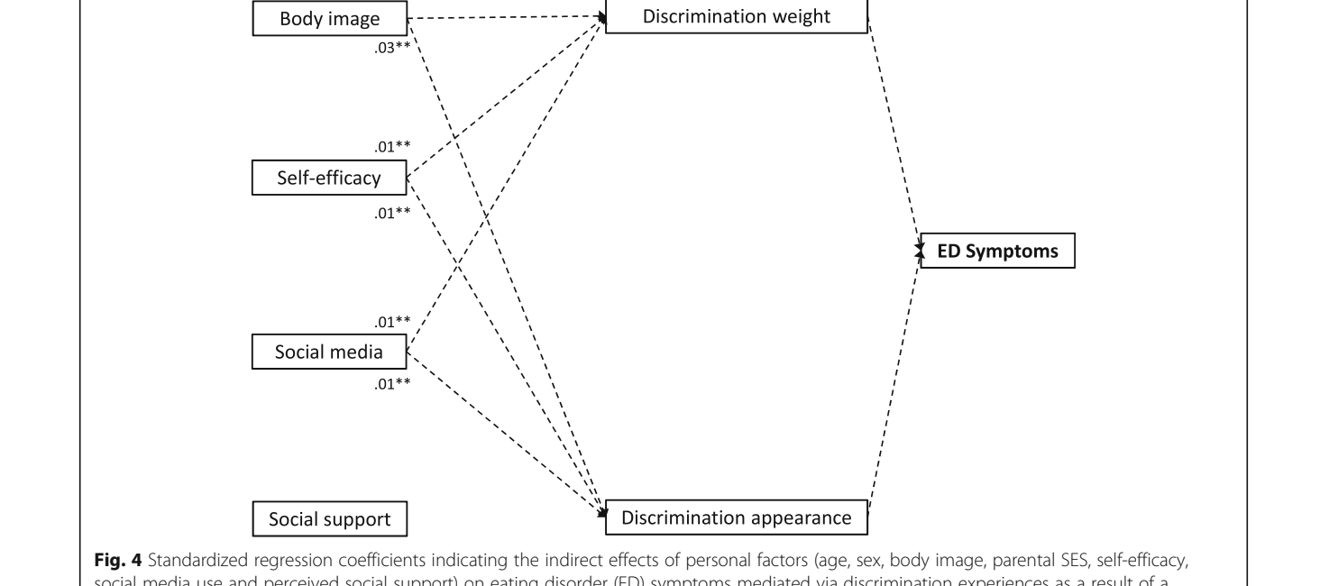
Example Study : Weight and Appearance Discrimination (Cohrdes, et al. , 2021)
Notes:
Cohrdes, C., Santos-Hövener, C., Kajikhina, K., & Hölling, H. (2021). The role of weight-and appearance-related discrimination on eating disorder symptoms among adolescents and emerging adults. BMC Public Health, 21(1), 1751.

Slide 13
So what about Jewish Body image
“funny but you don’t look Jewish”

Slide 14
Jews, discrimination and body image
Discrimination is a risk for ED pathology - applies to all discriminated groups studied (meta-analysis) - and remember the other factors/abuse happens to the body
Antisemitism and BI/ED - not well studied - but likely
Physical stereotypes of Jews and BI/ED - open for exploration
  (Streigel-Moore, 2002): White participants with ethnic features noted impact discrimination
  American whiteness/thinness part of the acculturation of Jews - lack of studies on the impact)
  Historical contrast: (Inquisition was based on social identity - changeable; Holocaust was race - fixed and physical)
Notes:
Streigel Moore ite women with ED were more likely to report discrimination based on ethnic features – were they Jews or other

Slide 15
Measuring Cultural and Religious Identity in Jewish Americans (Friedlander, et al., 2010)
Religious Identity Statements
  I show my Jewish Identity by the way I dress
  I observe the Sabbath
Cultural Identity Statements
  I feel connected to Judaism through my Jewish ancestors
  I am active in a Jewish community center or organization
Notes:
The authors conducted 3 studies to develop and investigate the psychometric properties of the American Jewish Identity Scales (AJIS), a brief self-report measure that assesses cultural identification and religious identification. Study 1 assessed the content validity of the item pool using an expert panel. In Study 2, 1,884 Jewish adults completed the initial AJIS and various measures of ethnic identity, collective self-esteem, and religiosity. Using confirmatory factor analyses, the authors selected and cross-validated 33 items that loaded highly and differentially on the 2 theorized latent factors. Study 3 assessed the AJIS's short-term stability and its relation to social desirability. Tests of reliability and construct validity provided initial psychometric support for the measure and confirmed the theorized primary salience of cultural identification. Participants reported significantly more private than public collective self-esteem, and the most Jewish-identified participants reported greater private self-esteem, acculturative stress, and perceived discrimination than did their more assimilated counterparts. (PsycInfo Database Record (c) 2020 APA, all rights reserved)

Slide 16
Jews in North America
Started 20th century as “other” based on physical and social traits
On becoming “white” over the 20th century - rhinoplasty
On re-embracing Jewish traits and appearance (natural hair, wearing jewelry & kippot)

Slide 17
Ultra-Orthodox and Eating Disorders
Bachner-Malman & Zohar 2019 review of cultural and religious impact
  Vulnerability: achievement pressures, selflessness in female role expectations, modesty that promotes body shame
  Protective: strong faith, connection between food and spirituality (e.g prayers before and after meals), modesty that reduces body objectification
Notes:
Became a concern about a decade ago – local “outbreaks” in orthodox communities. Some services for the orthodox

Slide 18
…and vulnerability in ultra-orthodox males (Laufer, et al., 2023)
Moving for residential yeshiva study at 14
Increase asceticism in isolated religious life

Slide 19

Where do we go from here to address JewishBody Image Issues & ED?

Slide 20
Case Example: Rachel/Rahel
19 year old American born daughter of Persian Jewish immigrants. Lives at home while attending local university studying pre-med. Mom has had cancer diagnosis and Rachel is performing additional caregiving duties as oldest daughter Experienced teasing about her looks including “Jewish nose” and short curvy figure during high school. Began using engaging in ED behaviors. States it continues to help her cope with stress.
Currently meets criteria for anorexia, binging-purging type
What do you want to explore about body image in psychotherapy?

Slide 21
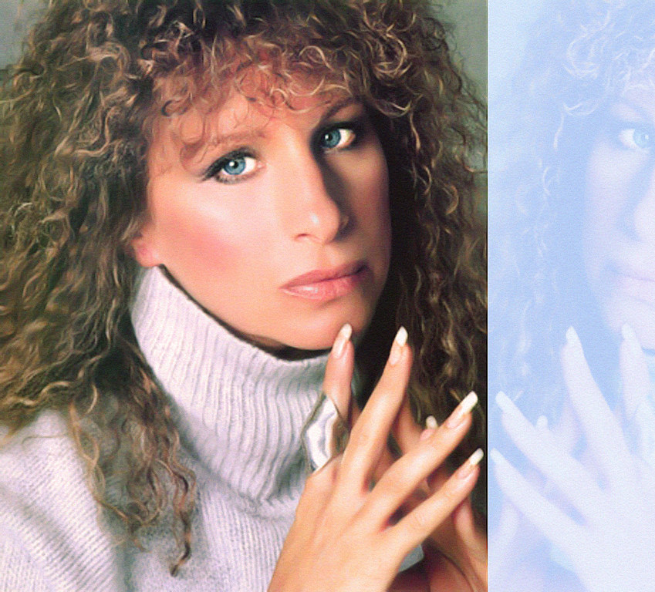
Research Questions:
Attitudes about body alteration of Jewish traits curly hair, rhinoplasty?
Impacts of wearing traditional dress and symbols?
Psychological impacts of increased antisemitism - impact body image or vulnerability to eating disorders?
Cultural comparisons among subtypes of Jews?
This Photo by Unknown Author is licensed under CC BY-ND

Slide 22
References
*Bachner-Melman, R., Zohar, A.H. Potential Risk and Protective Factors for Eating Disorders in Haredi (ultra-Orthodox) Jewish Women. J Relig Health 58, 2161–2174 (2019). https://doi.org/10.1007/s10943-019-00854-2
*Cohrdes, C., Santos-Hövener, C., Kajikhina, K., & Hölling, H. (2021). The role of weight-and appearance-related discrimination on eating disorder symptoms among adolescents and emerging adults. BMC Public Health, 21(1), 1751.
*Friedlander, M. L., Friedman, M. L., Miller, M. J., Ellis, M. V., Friedlander, L. K., & Mikhaylov, V. G. (2010). Introducing a brief measure of cultural and religious identification in American Jewish identity. Journal of Counseling Psychology, 57(3), 345–360. https://doi.org/10.1037/a0019577
*Glenn, S. A. (2010). Funny, you don’t look Jewish”: Visual stereotypes and the making of modern Jewish identity. Boundaries of Jewish identity, 64-90.
*Laufer, S., Herman, E., Serfaty, D., Latzer, Y., Ashkenazi, R., Attias, O., ... & Stein, D. (2023). Case report: Anorexia nervosa and unspecified restricting-type eating disorder in Jewish ultra-orthodox religious males, leading to severe physical and psychological morbidity. Frontiers in psychiatry, 14, 966935.
*Mason, T. B., Mozdzierz, P., Wang, S., & Smith, K. E. (2021). Discrimination and eating disorder psychopathology: A meta-analysis. Behavior Therapy, 52(2), 406-417.
*Milligan, A. K. (2014). Expanding Sisterhood: Jewish Lesbians and Externalizations of Jewishness. Journal of Lesbian Studies, 18(4), 437–455. https://doi.org/10.1080/10894160.2014.908270
*Striegel-Moore, R. H., Dohm, F. A., Pike, K. M., Wilfley, D. E., & Fairburn, C. G. (2002). Abuse, bullying, and discrimination as risk factors for binge eating disorder. American Journal of Psychiatry, 159(11), 1902-1907.Webb, J., & Jafari, N. (2017). Body objectification. In The SAGE encyclopedia of psychology and gender (Vol. 4, pp. 238-243). SAGE Publications, Inc., https://doi.org/10.4135/9781483384269.n78

